Slide 1


CarLO
Car Rental Online
MEMBERS :-
Vedant Dinkar: 220001078 (Leader)
Sarthak Brar: 220001070
Satya Narayan: 220001071 Saket Prashant Thamke: 220001067

Slide 2
User Interface
1
Browsing and Selection
Users can login and easily browse and select their desired car from our extensive collection using our intuitive and responsive website design.
Reservation and Booking
2
After selecting a car, the website seamlessly guides users through the reservation and booking process, ensuring a hassle-free experience.
3
Payment and Confirmation
Once the booking is cross-checked by the user, they can use PayTM/BHIM UPI or use their Credit/Debit Cards to make their payment online to receive confirmation.

Slide 3
Admin Interface
1
Admin Login
Admin will have an Authentication System to ensure security of the website
Check Bookings
2
After an order has been completed, the admin can navigate through the Car Bookings done recently.
3
Add Cars
The Admin can enter details of cars such as Model Name, Year of Manufacture, Price Per Hour and enter them into the Cars Table
Manage Reviews
4
The Admin can see the top reviews from customers and push those reviews into the front-end from the Reviews Table.
5
Push Locations
The Admin can enter new locations of our latest centers into the Centers Table.

Slide 4
Technology Stacks Used
Front-end: HTML → Structural Backbone CSS → Beautiful Animations and Cards JavaScript → Complex Animations and onClick Events
Back-end: Node.js → Full-stack JavaScript, Vast Packages Express.js → Fast, Scalable, Simple Routing
Database: PostgreSQL→ Open Source, RDBMS, Data Integrity
Other tools: Git, GitHub, VS Code

Slide 5
Key Features of the Website
1
Login System
2
Wide Car Selection
3
Easy Reservation Payments
Authorization System ensures friendly and secure interface for the Users as well as the Admins.
Choose from a wide range of luxurious and reliable cars for all your travel needs.
Complete bookings easily using multiple payment methods

Slide 6
Challenges Faced During Development
User-Friendly Interface
Browsing Models
Third-Party Integrations
To ensure hassle-free task for the Admins, we are in the stage of browsing for Models having an impressive accuracy to aid in their task.
Designing an intuitive and user-friendly interface that caters to a wide range of users with varying technical proficiency was challenging.
Integrating various third-party systems, such as map services, required meticulous planning and coordination.

Slide 7

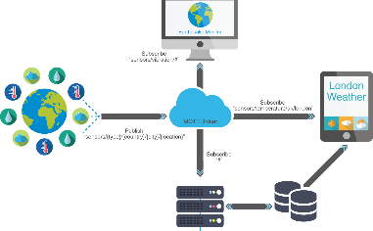

Future Plans and Improvements
User Interface
Deploy the Website
Use of Machine Learning
We plan to improve our front-end by creating pages such as User Bookings
We aim to deploy the website onto a robust and secure server, guaranteeing peak performance and seamless accessibility for all our users.
To ease Admin's Manual Tasks, we plan on integrating various Machine Learning Algorithms to ensure a spam filter in reviews

Slide 8
THANK YOU!

